Slide 1
Hooghly Imambarah
بِسْمِ اللہِ الرَّحْمٰنِ الرَّحِیْمِ
A Project Report – November 2010

Slide 2
Presentation Flow
Hooghly – Location in India
History of Hooghly
Shia Properties
Imambarah & Its Contributions
Govt. of Bengal & Wakf Board
Our Objective
The Way Ahead
  Risk Factors
  Timelines & Expenses

Slide 3
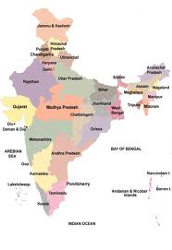
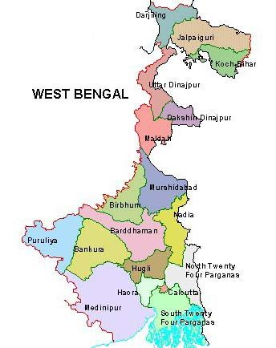
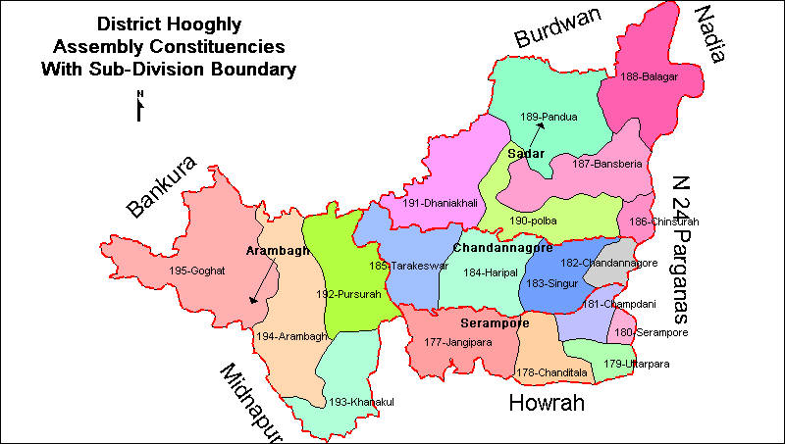
Hooghly – Location in India
Hooghly
West Bengal
India

Slide 4
Hooghly – Location in India
Approx. 55 km from Kolkata

Slide 5
History of Hooghly
Aga Motahar & his wife settled in Bengal during Auranzeb’s regime
Aurangzeb awarded him with the following properties
  Pargana Magura, a district of 24 Parganas
  Khulna
  Jessore
  Murshidabad
  Nadia
All property including Touzi No. 92 comprising of more properties were given to Aga Motahar’s daughter Mannujan Khanam

Slide 6
History of Hooghly…
This included the following Mouzas
  Kidderpur
  Rajarampur
  Daulatpur
  Sonai
  Benodepur
All of this devolved upon her uterine brother Haji Mohammad Mohsin
Haji Mohsin formed a public and religious endowment
To be managed by the Board of Revenue under the Bengal Regulation XIX of 1810

Slide 7
History of Hooghly…
This property came to be known as the ‘Hooghly Imambarah Estate’
As per the Religious Endowments Act 1836, this was to be managed by the Committee of Management appointed on 30 October 1863
Committee of Management was fully constituted on 1 April 1876
The Kharij Towleat Property comprising of Kidderpore, Sonai, Rajarampur & Benodepur of Touzi No. 92, 24 Parganas Distt, were also to be managed by the Committee U/S 6 & 8 of Act VII of 1863

Slide 8
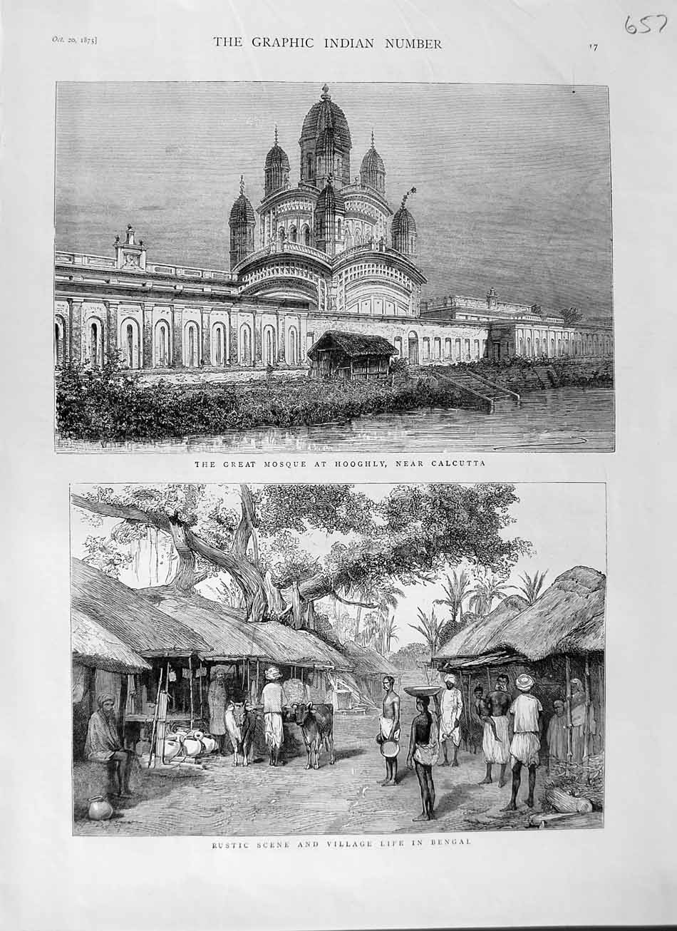
Hooghly Imambarah, 1875

Slide 9
Hooghly Imambarah Properties
In addition to the properties mentioned earlier, the following are also a part of the Hooghly Imambarah Properties
  After a dispute over the ownership of Touzi No. 92 between the Mutawalli and Ramtonu Saha & Madhusudan Mukhopadhyay, 80 bighas of (approx. 1,60,000 sq. meters) was registered in Touzi No. 92 of Mouza Kidderpore at an annual rent of Rs. 886/-
  Haji Mohammad Mohsin had created a fund with Rs. 10 lakh which swelled to Rs. 1,25,14,300/- in 2003 and is with the Reserve Bank of India
  As per a report in اخبار مشرک گلدستہ 13 November 2005, 8 Maund silver (approx. 298 kg) and 1750 seer gold (1 seer = 933 gm) is lying with the Banks

Slide 10
Hooghly Imambarah Properties…
  The Hooghly Imambarah a.k.a. The Burra Imambarah
  A house at the east of this Imambarah
  Shia burial ground to the south of and opposite to the Imambarah
  Many other properties, the value of which today would run into hundreds of crores, are mentioned in the ‘Blue Book’. This book contains a vast, but not exhaustive, list of properties most of which is large pieces of land in the nearby as well as far off areas from Hooghly.
  The list of Kharij Towleat properties is also vast and is mentioned in the ‘Blue Book’ (a few extracts of the book are attached with this presentation).

Slide 11
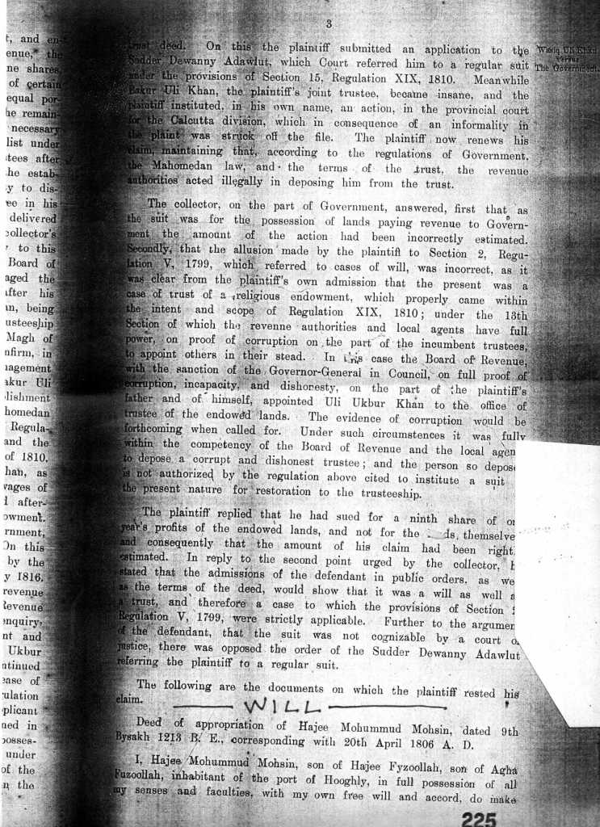
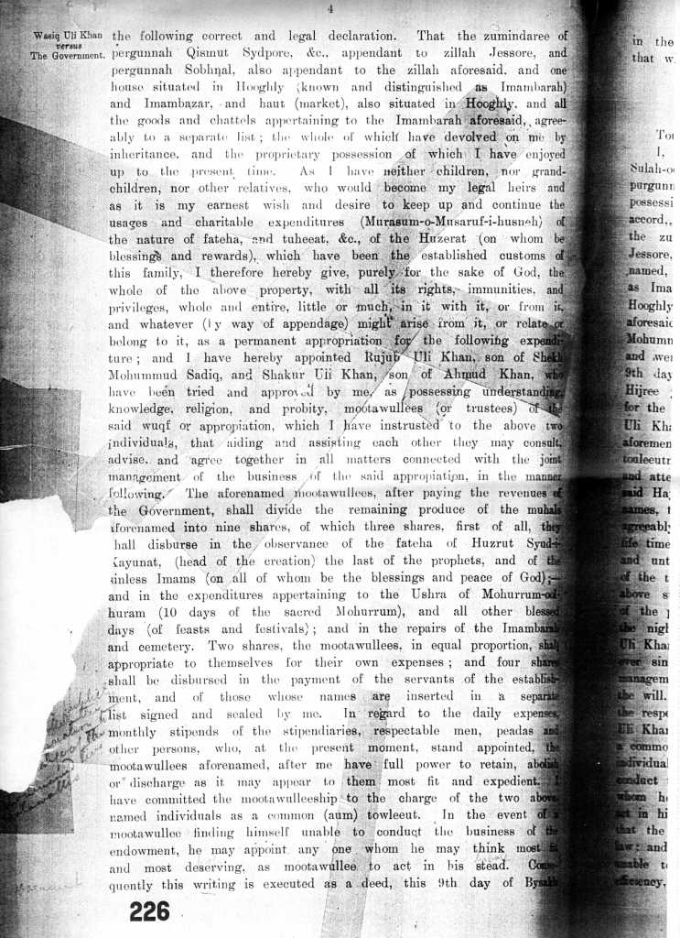
The Will of Haji Mohammad Mohsin

Slide 12
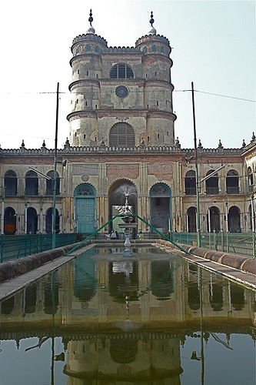
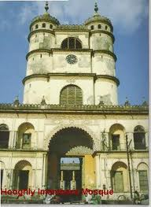
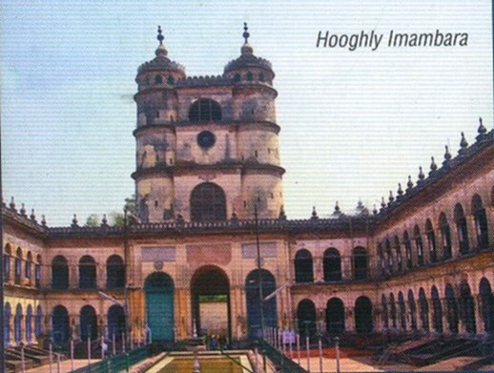
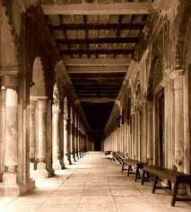
Hooghly Imambarah Today

Slide 13

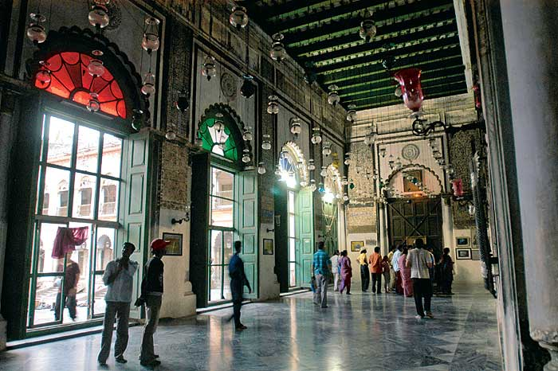
Hooghly Imambarah Today…
The clock on the tower is a replica of “The Big Ben” and in itself is antique and priceless
Chandeliers in the Imambarah have been given by several rulers, including Tipu Sultan, and need protection
The record room of the Imambarah also holds very valuable manuscripts

Slide 14
Imambarah & Its Contributions
Donations
  More than 30 acres of land for ‘Mohsin College’, the most popular and largest college in Hooghly
  Approx. 20 acres of land for ‘Imambarah Sadar Hospital’
  Large areas in Hooghly have been donated to or acquired by the Government for building police line barracks, bridges, roadways where compensation is still to be received from the authorities
Hauza-e-Ilmiyah in the Imambarah premises
  Run by Imaan Foundation

Slide 15
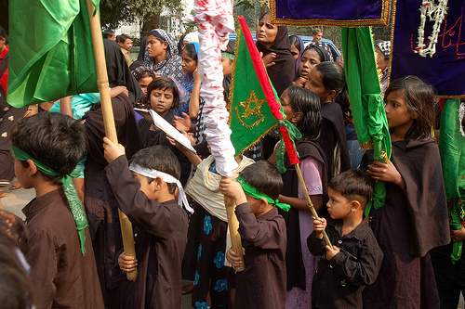
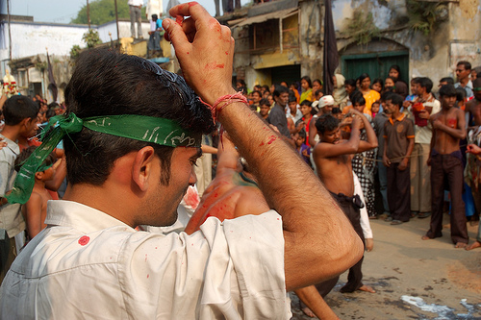
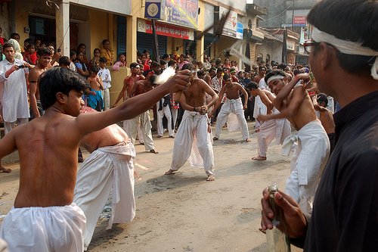
Azadari at Hooghly

Slide 16
Govt. of Bengal & Wakf Board
All of these properties are under the Religious Endowment Act and not under Wakf Act
Hence, as per law, its management was not under the Govt. of Bengal
However, it was handed over to Wakf Board by the Committee of Management in 2002
As a result, it is now controlled by the Wakf Board
It is being used for the benefit of the Wakf Board

Slide 17
Our Objective
Property belongs to the Shias for their benefit and the benefit of the Imambarah
It is currently being neglected and misused
No effort is being made to identify the other properties of the Imambarah nor to save them
If this continues then this property will remain unutilized and others will continue to reap benefits out of this property since there has already been a lot of activity on it

Slide 18
The Way Ahead
We need to claim our legal right over the properties of the Imambarah
The Khoja Shia Ithna Ashari Jamat is defunct in Kolkata
Only an Imambarah (like Mehfil-e-Khurasaan at Dongri) run by the Khojas exists
Imambarah Estate needs immediate attention because of its worn out condition
Risk Factors
  It is a tedious and a lengthy process
  Fighting a state govt. is not so easy
  Might take years to get justice

Slide 19
The Way Ahead…
Timelines & Expenses
  It would take minimum three months to get started
  Expenses might run into lakhs considering the legal charges as well as repairs of the Imambarah
However, ultimately, Hooghly can be looked upon as a haven to innumerable Shias for generations to come
It would pave the way for Shiaism in and around the Imambarah Estate

Slide 20
Kolkata Imambarahs are a very large chapter by themselves. We shall send you detailed information of their difficulties, actions taken by us to save them against land mafias, crooks and goons.
God willing, we shall not waste a single opportunity of trying to get all this back on track. We intend to host a website which will help protect all the Imambarahs in India as this is exactly what we are supposed to do.
We are very grateful to you for having taken so much interest for something where people either shirk or shun and give nothing but verbal assurances.
وَ آخِرُ دَعْوَانَا اَنِ الْحَمْدُ لِلّٰہِ رَبِّ الْعَالَمِیْنَ

