Slide 1
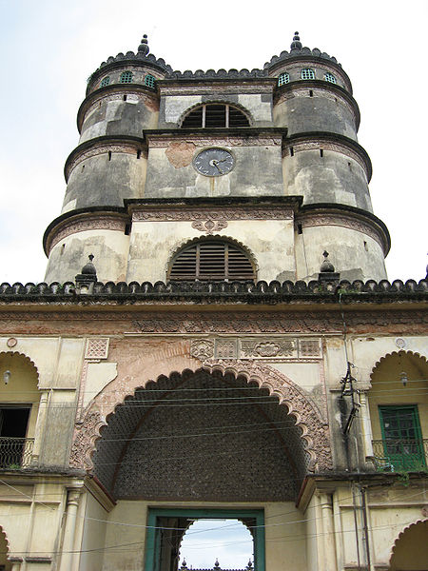
History of Hoogly
West Bengal

Slide 2
Hooghly
The district of Hooghly had been colonized by different civilization from the pre historic times. However the history of the region was recorded from the time it existed to be the kingdom of the Suhmas, a valiant tribe who were the juxtaposition of the Angas, Vangas & Pundras. In Mahabharata, mention of these tribes has been made. The reference of the Suhmas in Mahabhasya of the 2nd century B.C clearly designates the existence of the region in the 2nd century B.C.
In the 3rd century B.C, when Ashoka of the Maurya dynasty rose into power and augmented his expedition, the major part of the region came under his sway, leaving almost none in the control of the Suhmas. The jurisdiction of Ashoka includes the whole area of Bengal, along the Gangetic plains, which even extends upto Tamralipta. However the region with the rest of Bengal was conquered by the successful campaign of Samudragupta and was attached in the territory of the Gupta Empire in the 4th century B.C

Slide 3
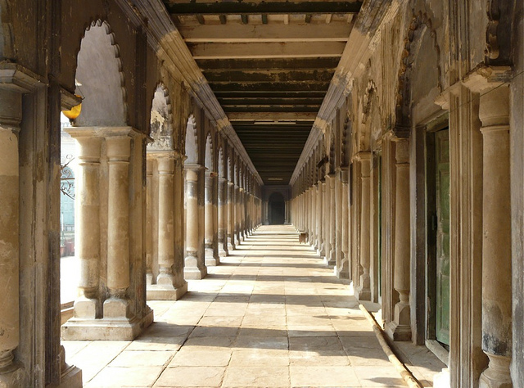
Being a part of the magnificent Guptas for several centuries, the region suffers a set back and immense loss when Sasanka, the vigorous king of Gaur expedite against the former princes and conquered Bengal, covering the region of present Hooghly. But Sasanka could maintain his kingdom, not for long and in the second half of the same century, Siladitya Harshavardhana became the domineer of whole area of Bengal. But the northern and eastern part of the present Hooghly was under the control of the Sena Kings, powerful in Bengal at that time.
The region was under the influence of the indigenous rulers till the 13th century when the Muslim invaded Bengal and established their supremacy suppressing the native rulers.

Slide 4
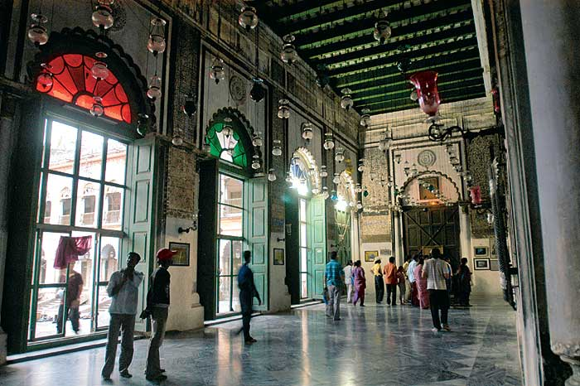
The Muslim supremacy was followed by the gradual uprising of the colonial forces in all over India, including the vast tract of Bengal. The Portuguese, Dutch and French, Danes and the English establish "Kuthis" in the district to serve the purpose of the business. It was the Portuguese, who build up the first port at the bank of the river Bhagirathi-Hooghly at the middle of the 16th century. The district progressively transmuted as the "window" for the foreign settlers. The trading race found the place profitable for carrying out their business allover the country, hence settled here with the latent desire to capture the political power. Chandernagore subdivision was under the French since 1696 to 1950 and the Chinsurah and Serampore sub division were under the influence of the Dutch and Danes respectively.
After the Battle of Plassey, when Mir Kasim, according to an agreement donated the zamindary areas of Burdwan, Midnapore and Chittagong to the British East India Company, the English rose into power. Having all the Zamindary areas of Bengal in clutch, it became somewhat effortless for the British to establish their political hold. The British, with the aim to install a firm hold, drive away the other races, formerly controlling Bengal. Consequently the areas around the Hooghly district, which was once used to be a transaction seat for the Portuguese and the Dutch, continued to exist within the territory of the British.

Slide 5
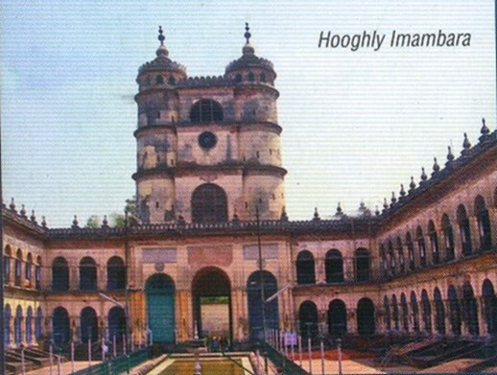
For administrative conveniences the district of Burdwan was splitted into two parts in 1795.The northern division being called Burdwan and the southern part came to be identified as Hooghly. The Bengal Presidency was divided into 14 subdivisions at that time of which Hugli was one. Hooghly became separate Collectorate in the year 1822 and Mr.W.H Belli was appointed as the first Collector. However the Collectorate came to be functioned as the separate district only after the independence.

Slide 6
Hooghly-Chinsurah is a city in the state of West Bengal, India. It lies on the Hooghly River, 35 km north of Kolkata (Calcutta). It is located in the district of Hooghly and is home to the district headquarters. Chinsurah houses the Commissioner of the Burdwan Range. It forms a part of the Kolkata Metropolitan Development Authority (KMDA) region.
Hooghly-Chinsurah was a municipality formed by the merging of two towns, Hooghly and Chinsura, in 1865. The names are spelled in various other ways including Hooghly, Hugli, Hughli, Chinsura, Chunchura and Chinsurah.
The Grand Trunk Road passes through the town. Chuchura and Hooghly are two historic stations on the Howrah-Burdwan main line of the Eastern Railway. Ferry services on the River Hooghly serves as a link with the district of North 24 Parganas.

Slide 7
Chuchura Ghorir More Clock Tower
The town of Hooghly-Chuchura was founded by the Portuguese in 1579. But, the district has thousands of years of rich heritage in the form of the great Bengali kingdom of Bhurshut. The city flourished as a trading port and some religious structures were built. One such structure is a Church dedicated to a Charismatic statue of the Mother Mary brought by the Portugese. In the 17th century, political disorder struck the city and the Mughal governor of Bengal expelled the Portuguese. The statue was lost in the river by the Portugese when fleeing. The statue was later found by the local people on the bank of the river. The arrested Portuguese were taken to Delhi where a death sentence of trampling by elephans was decreed. When the emperor Shah Jahan heard this he ordered the priests released and granted a piece of land on the bank of the river Hoogly where the statue of the Mother Mary was reestablished. There a church was constructed to house the statue, which still receives pilgims today. The church was renovated in 1980s and has been declared as a basilica by the authority of Rome.

Slide 8
In 1656 the Dutch erected a factory on the site of the town. At that time Kolkata was the principal Dutch settlement in Bengal, used as a base for the Dutch intra-Asian opium trade.
In 1759 a British force under Colonel Forde was attacked at the Battle of Chinsurah by the garrison of Chinsura on its march to Chandernagore. In less than half an hour the Dutch attackers were entirely routed. In 1795, during the Napoleonic wars, the settlement was occupied by a British garrison. At the peace of 1814 it was restored to the Dutch. It was among the cessions in India made by the king of the Netherlands in 1825 in exchange for the British possessions in Sumatra.
Both Chinsurah and Hooghly played an active role in the Bengal renaissance and the Indian independence movement. "Vande Mataram", India's national song, was composed by Bankim Chandra Chattopadhyay at Joraghat in Chinsurah. Nazrul Islam's famous revolutionary songs were penned while he was imprisoned by the British in Hooghly Jail.

Slide 9
Haji Md. Mohsin
Haji) Muhammad Mohsin (Bengali: (1732–1812) was one of the most prolific philanthropists in the history of Bengal. His most notable contribution was during the great famine of Bengal during 1769-70.
Mohsin was born to Haji Faizullah and Zainab Khanam in Hughli (now in West Bengal, India) in 1732. He was home-schooled and gained knowledge in the study of the Quran, Hadith and the Fiqh. Later, he went on a voyage to other countries of Asia, including the regions in current-day Iran, Iraq, Turkey and the Arab peninsula. He also made the pilgrimage to Mecca, and visited Medina, Kufa, Karbala and other holy places. After performing the Hajj, he was given the title Haji.

Slide 10
Following his return, Mohsin took over the management of the estate of his widowed half-sister, Munnujan. She was the widow of Mirza Salahuddin, the Naib-faujdar or Deputy Military Governor of Hughli working for the Nawab of Bengal. She also inherited a fortune from her mother Zainab, whose first husband Aga Motahar had a lot of land and properties in Hughli, Jessore, Murshidabad and Nadia.
After Munnujan's death in 1803, Mohsin inherited the fortune. However, he decided to bequeath this fortune for charity, and created a Waq'f or trust in 1806, with his entire wealth of 156,000 Taka.One-third of his fortune was to be donated for education and religious programmes, four-ninths for pensions to the elderly and disabled, and the remaining two-ninths for the expenses of the two trustees.
Mohsin died on 29 November 1812. Following his death, the government of Bengal (then the British East India Company) took over the management of the trust, and many educational institutions were started with the grants from the trust. Many students, especially the poor Muslim students, were given scholarships from the Mohsin fund.

Slide 11
The Board of revenue was empowered to manage the said endowment under the Bengal Charitable Endowments, Public Buildings and Estates Regulation known as Bengal Regulation XIX of 1810.
By virtue of a judgment and order of the then Sardar Dewani Adalat in the case of Wasik Ali Khan Versus Government on 22nd September, 1836 decree the suit in favour of the Government as result whereof the properties in the said endowment and the management thereof vested in the state.
From 1863 the said Hooghly Imambara Estate was governed by the Religious Endowment Act XX of 1863 and managed by a committee of management appointed under the R.E. Act and its first president was Justice Ameer Ali, Chief Justice Privy Council, London.
Since 1863 onwards respective Committee managed the Hoogly Imambara Estate when owing to dissension an official Receiver was appointed in or around 1956.
About 1975 a fresh Committee of Management took charge from the Official Receiver.

Slide 12
In 1985 owing to differences between committee members, The District Judge Hoogly appointed Tajem Ali a Sunni advocate as the Administrator.
The above appointment of Tajem Ali was disputed before the High Court, Calcutta which removed Tajem Ali and appointed Shahbir Naqvi a Shia from Patna as administrator.
In 1988 the Calcutta High Court appointed Sardar Amjad Ali an advocate and Nazim Ali Mirza a shia as Joint Administrator.
In 2011 valuable Chandelier of the Imambara were stolen.
In 2002 the Calcutta High Court directed the B board of Wakf to appoint a five member committee of Management, which it did in 2002.

Slide 13
The new committee of Management did not take charge from the Joint Administrators but broke open the padlocks and messed up all documents papers, deeds, valuables jewellery religious relics for their own vested interest.
The above committee was the puppet of the Board of Wakf and the state Government which does not want to reveal and identify the goods and assets of the Hoogly Imambara, since most of these have and are being misused mismanaged used by the State Government.
Since around 1930 the Hoogly Imambara Estate has been made to suffer indefinable losses and its assets are being forfeited because of proper fight back.
A very lard area of this estate is in Syedpor Khulna, Jessore etc area of Bangladesh.
A substantial amount of about Rs 2 crores is lying with the Reserve Bank of India called Education Fund which none wants to reveal.
A substantial amount of Religious Jewellery and gold is lying with the Government Treasury without any doubt whatsoever.

